Slide 1
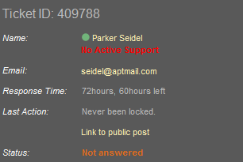
Create the following page section using HTML and external CSS (no inline styles). Use a table or a definition list (in this case the layout will be different).

Slide 2
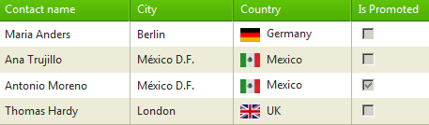
Create the following Web page using external CSS styles.
Create a web page using design below and the HTML markup in index.html.

Slide 3
